Slide 1
RNA-seq (pair-end) data analysis report
Analyze by Xu Huijuan
Data from Wang Dongpeng lab

Slide 2
Output 1
Data statistic
 | raw reads | filtered reads | unique mapped reads | removed duplicate reads | gene reads
231_CO | 32,439,863 | 32,426,950(0.9996) | 26,514,838(0.8177) | 22,531,454(0.8498) | 11,073,969(0.4915)
231_CO.rep1 | 13,375,834 | 13,372,018(0.9997) | 10,803,327(0.8079) | 9,075,762(0.8401) | 4,704,178(0.5183)
231_CO.rep2 | 14,745,359 | 14,742,142(0.9998) | 11,661,006(0.7910) | 9,680,910(0.8302) | 4,944,177(0.5107)
231_CO.rep3 | 10,540,002 | 10,537,533(0.9998) | 8,564,339(0.8127) | 7,246,793(0.8462) | 3,736,973(0.5157)
231_MO | 78,002,457 | 77,966,302(0.9995) | 62,528,379(0.8020) | 51,190,244(0.8187) | 24,512,701(0.4789)
231_MO.rep1 | 51,698,809 | 51,688,586(0.9998) | 42,668,157(0.8255) | 35,576,977(0.8338) | 17,505,649(0.4920)
231_MO.rep2 | 21,396,340 | 21,391,707(0.9998) | 17,636,655(0.8245) | 14,933,741(0.8467) | 7,548,944(0.5055)
231_MO.rep3 | 18,683,352 | 18,679,092(0.9998) | 15,178,518(0.8126) | 12,790,867(0.8427) | 6,437,798(0.5033)
iN_CO | 17,184,428 | 17,167,412(0.9990) | 14,192,259(0.8267) | 12,454,089(0.8775) | 4,724,579(0.3794)
iN_CO.rep1 | 8,142,106 | 8,140,322(0.9998) | 6,636,300(0.8152) | 5,809,030(0.8753) | 2,399,050(0.4130)
iN_CO.rep2 | 11,329,729 | 11,327,239(0.9998) | 9,384,524(0.8285) | 8,211,885(0.8750) | 3,356,424(0.4087)
iN_CO.rep3 | 14,423,124 | 14,420,151(0.9998) | 11,844,755(0.8214) | 10,327,647(0.8719) | 4,145,034(0.4014)
iN_MO | 30,300,170 | 30,270,172(0.9990) | 25,724,694(0.8498) | 22,631,372(0.8798) | 8,876,690(0.3922)
iN_MO.rep1 | 2,159,927 | 2,159,428(0.9998) | 1,710,129(0.7919) | 1,500,410(0.8774) | 644,251(0.4294)
iN_MO.rep2 | 4,612,948 | 4,611,911(0.9998) | 3,564,215(0.7728) | 3,055,149(0.8572) | 1,303,885(0.4268)
iN_MO.rep3 | 5,049,636 | 5,048,493(0.9998) | 4,132,007(0.8185) | 3,646,870(0.8826) | 1,558,827(0.4274)

Slide 3
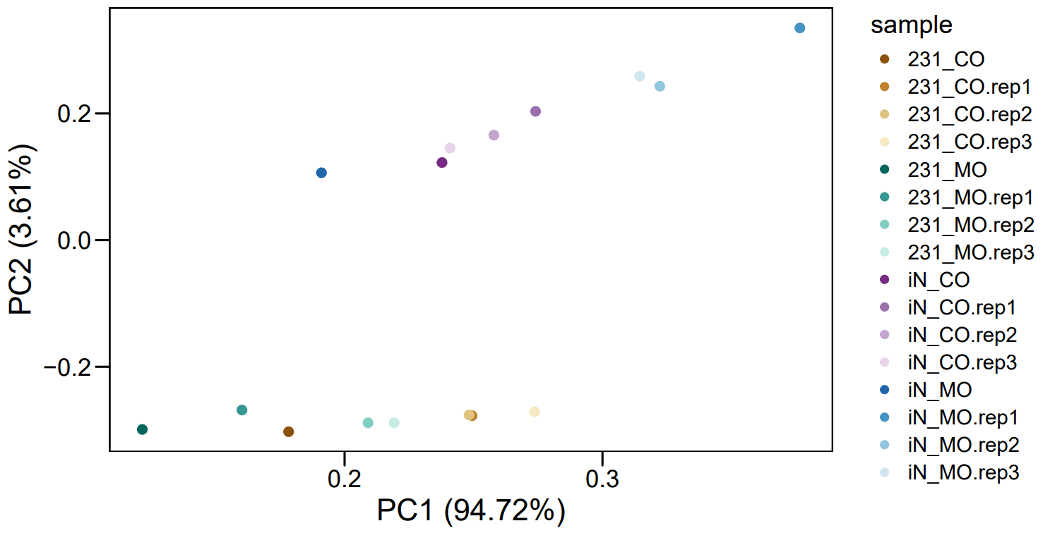
Output 3
2) PCA plot
Comments:
231_CO, 231_MO, iN_MO should be discarded.
So, reserved samples:
231_CO.rep1, 231_CO.rep1, 231_CO.rep1,
231_MO.rep1, 231_MO.rep2, 231_MO.rep2,
IN_CO.rep1, IN_CO.rep2, IN_CO.rep3,
IN_MO.rep1, IN_MO.rep2, IN_MO.rep3

Slide 4
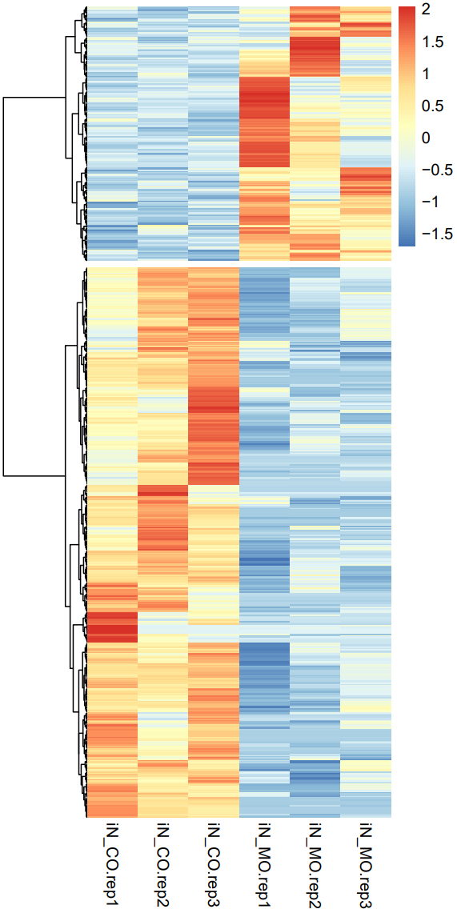
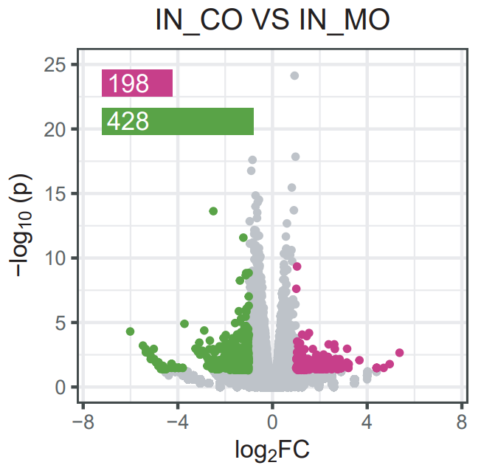
Output 3
4) volcano plot
5) DEG heatmap

Slide 5
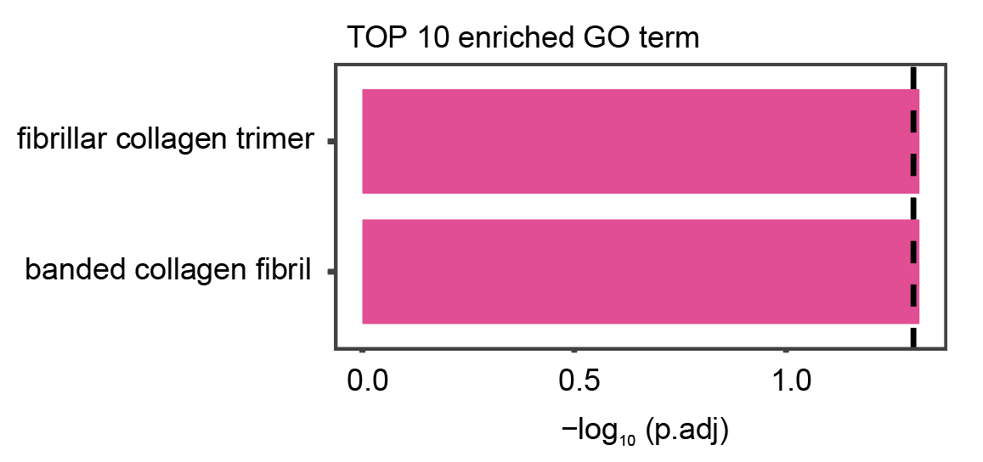
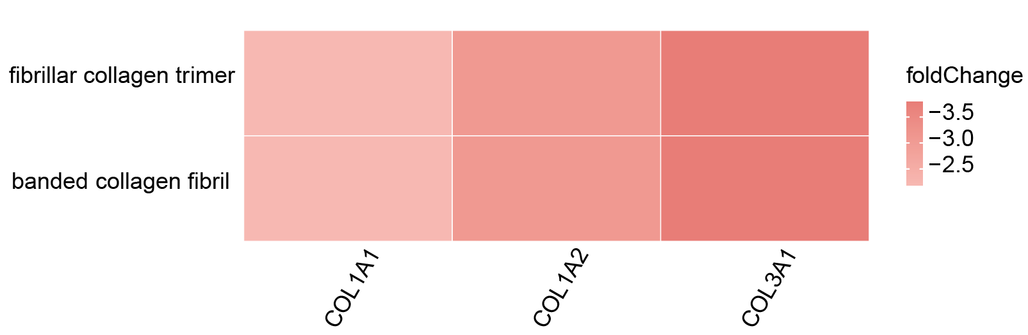
Output 3
6) DEG GO enrichment
Comments:
DEG were enriched in only two GO pathways, while no significant results were found in the KEGG analysis.

